Slide 1
Fraud Detection & Prevention
Team 036 - Alejandro De Jesus, Leslie Francis, Tania De Pena, Vaisag Radhakrishnan

Slide 2
Background
According to the new “State of Fraud 2023” study from fraud prevention solution provider Signifyd, the total cost of e-commerce fraud in 2023 will reach $206.8 billion
These frauds affect both companies as well as customers. Although most banks will reimburse fraudulent transaction cost, it gets passed to the customer
Effective fraud detection can protect customer data and maintain trust between companies and their clients.

Slide 3
Problem Statement
We aim to find whether a given e-commerce transaction is fraudulent or not
We also aim to answer other descriptive analytics questions such as
Which demographic of the population is more likely to commit fraud?
Is fraud committed at a certain time of the day or certain days or periods in a year?

Slide 4
Initial Hypothesis
Our initial hypothesis is that young people are more likely to commit fraud
Fraud is committed on high value popular items

Slide 5
Research Paper Findings
Most papers focus on the predictive performance as opposed to the interpretation of the model - while predictive performance is important, interpreting a model is equally important to make critical business decisions.
Most fraud detection datasets are imbalanced and it is extremely important to balance the dataset to get good predictive performance

Slide 6
Dataset
Data for this analysis will be used from Kaggle Repository
There are mainly two datasets:
Fraud data table: This has the transaction along with customer demographics and fraudulent indicator
IP Address Lookup: Ip address to country lookup

Slide 7
Challenges
Most publicly available datasets have masked columns
When its not masked, the number of columns are limited
Number of training records are limited

Slide 8
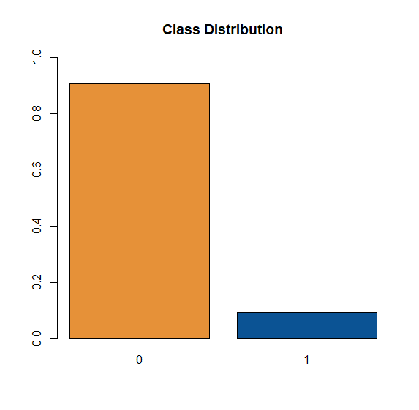
Overview of the Data
Dataset is taken from Kaggle: “Fraud ecommerce” By Binh Vu
There are 151,000 transactions made from January 2015 to December 2015
14,000 fraudulent transactions and 138,000 non-fraudulent transactions

Slide 9
Key Variables
Feature Description | Type
Amount of the purchase | Numeric
Date and time of the purchase | Date
Used Browser for the transaction. | Categorical
Source (Direct, Ad, etc.) | Categorical
Date and time of the sign up | Date
Age | Numeric
Gender | Categorical
Ip address | Numeric

Slide 10
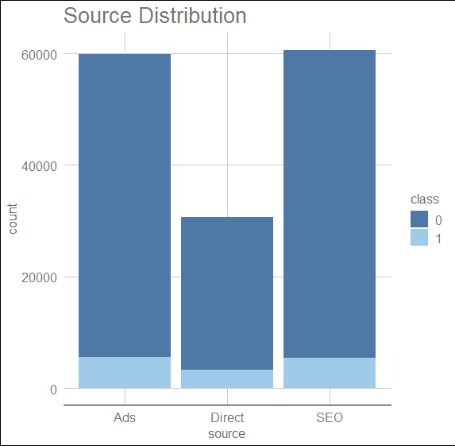
Exploratory Data Analysis
Least used source of purchase is Direct purchase
This is expected, as companies tend to spend more money on SEO and Ads

Slide 11
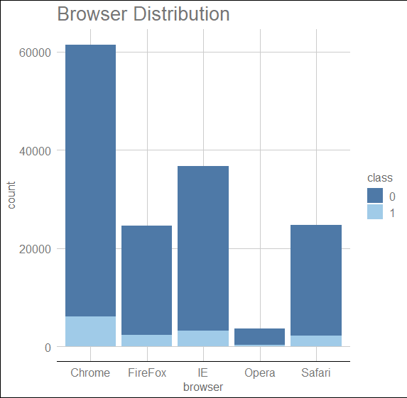
Exploratory Data Analysis
Chrome is the most used browser
Opera is the least used one

Slide 12
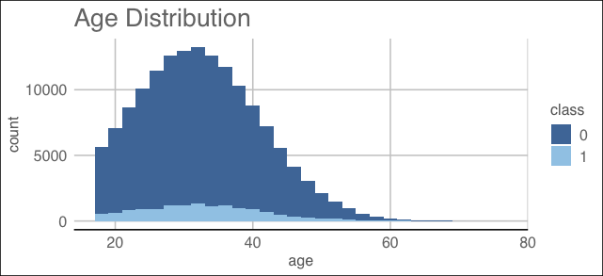
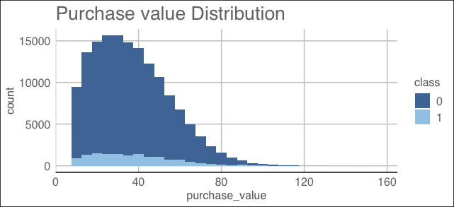
Exploratory Data Analysis
Both Age and Purchase Value have a right skewed distribution

Slide 13
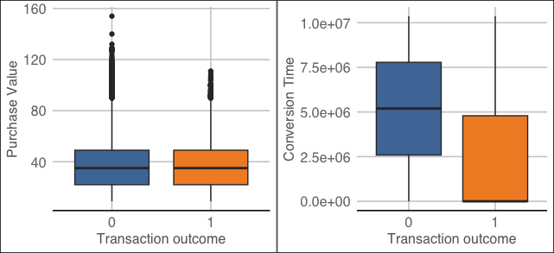
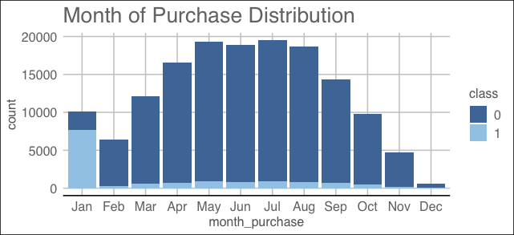
Exploratory Data Analysis
Fraudulent transactions occur on same day signup and purchases.
January had the most fraudulent transactions compared to other months.

Slide 14
Exploratory Data Analysis
We analyzed feature difference between fraudulent and non fraudulent transactions. Conclusions:
Most fraudulent browser: chrome (43%) vs the average (40.7%)
Frauds are more likely on weekends: 46.4% weekend propensity vs 43.1% the average)
Purchases made the same day of sign up have higher propensity for fraudulent transactions

Slide 15
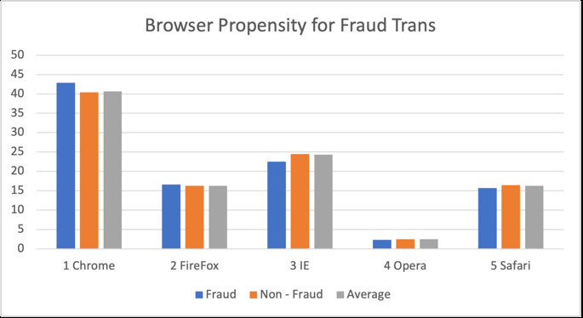
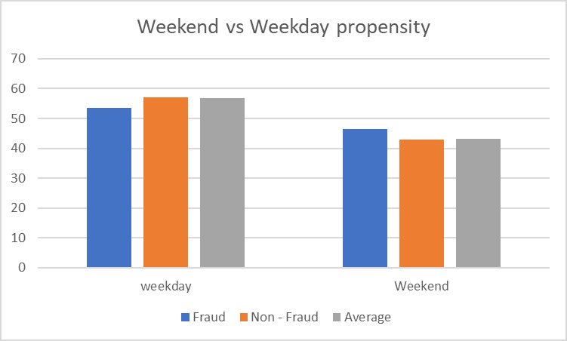
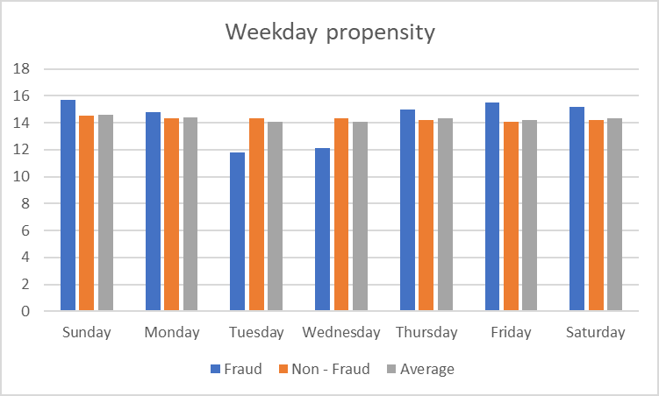
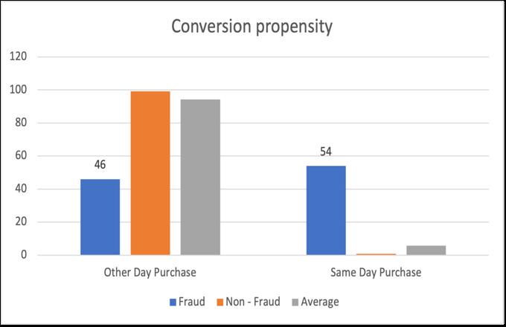
Exploratory Data Analysis

Slide 16
Data Wrangling/Data Preparation
Fraud data and ip_address data was joined to get the country information
There were no null values however colums with NA was replaced with Unknown
Additional variables were derived as explained in the feature engineering slide
Data imbalance was addressed using SMOTE technique

Slide 17
Feature Engineering
Following new variables were derived
Variable Name | Description
seo | 1 when purchase was made from SEO otherwise 0
ads | 1 when purchase was made via ad else 0
Chrome | 1 when browser used is Chrome else 0
Safari | 1 when browser used is Safari else 0
Opera | 1 when browser used is Opera else 0
Ie | 1 when browser used is IE else 0
Male | 1 when male else 0
Young | 1 when age < 30 else 0
Middle_aged | 1 when age is between 30 and 50 else 0
Monday – Saturday (6 variables) | Monday = 1 when purchase day is Monday, Tuesday = 1 when purchase day is Tuesday etc.
Weekend | 1 when purchase is on a weekend else 0
Night | 1 when purchase is in the night else 0
Afternoon | 1 when purchase is in the afternoon else 0
Evening | 1 when purchase is in the evening else 0

Slide 18
Model Training
Create folds for K-Folds Cross Validation
Trained logistic regression and KNN models for each hyper-parameter with K-folds.
Run it against test sample
Get mean of F1 score to compare performance of model

Slide 19
Model Types - Results
 | Model Name | Mean F1 | Mean Threshold
1 | Logistic Regression: high propensity predictors | 0.667 | 0.98
2 | K Nearest Neighbor (k=15) | 0.405 | -
3 | K Nearest Neighbor (k=13) | 0.401 | -
4 | K Nearest Neighbor (k=11) | 0.396 | -
5 | K Nearest Neighbor (k=9) | 0.390 | -
6 | K Nearest Neighbor (k=7) | 0.383 | -
7 | K Nearest Neighbor (k=5) | 0.372 | -
8 | K Nearest Neighbor (k=3) | 0.354 | -
9 | K Nearest Neighbor (k=1) | 0.334 | -
10 | Logistic Regression: all predictors | 0.169 | 0.99
* SVM was not trained due to computing power restrictions

Slide 20
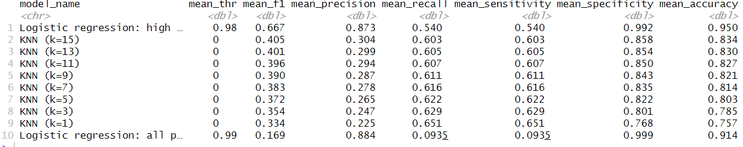
Model Types - Results (hidden)

Slide 21
Conclusions and Suggestions
Logistic regression with high propensity showed promising results as hypothesized
Suggestions for the stakeholder would be to reject predicted fraudulent transaction and notify customer
Restrict same-day purchases by adding security measures like two-factor-authentication

Slide 22
Next steps
If given more time, we would:
Try other methods of feature selection
Undersample dataset in order to try training SVM
Train more KNN models to see if there are better k values
Try other classification models

Slide 23
References
Varmedja, Dejan, et al. "Credit card fraud detection-machine learning methods." 2019 18th International Symposium INFOTEH-JAHORINA (INFOTEH). IEEE, 2019.
Awoyemi, John O., Adebayo O. Adetunmbi, and Samuel A. Oluwadare. "Credit card fraud detection using machine learning techniques: A comparative analysis." 2017 international conference on computing networking and informatics (ICCNI). IEEE, 2017.
“New FTC Data Show Consumers Reported Losing Nearly $8.8 Billion to Scams in 2022.” Federal Trade Commission, 23 Feb. 2023, www.ftc.gov/news-events/news/press-releases/2023/02/new-ftc-data-show-consumers-reported-losing-nearly-88-billion-scams-2022.
“New Data Shows FTC Received 2.8 Million Fraud Reports From Consumers in 2021.” Federal Trade Commission, 22 Feb. 2022, www.ftc.gov/news-events/news/press-releases/2022/02/new-data-shows-ftc-received-28-million-fraud-reports-consumers-2021-0
Berthiaume, Dan. “Study: Total E-commerce Fraud in 2023 Will Exceed $200 Billion.” Chain Store Age, 25 Jan. 2023, https://chainstoreage.com/study-total-e-commerce-fraud-2023-will-exceed-200-billion#:~:text=According%20to%20the%20new%20%E2%80%9CState,tangible%20losses%20for%20online%20retailers
Brownlee, Jason. “Cost-Sensitive Learning for Imbalanced Classification”, 7 Feb. 2020, https://machinelearningmastery.com/cost-sensitive-learning-for-imbalanced-classification/

Slide 24
References (Contd.)
Brownlee, Jason. “A Gentle Introduction to Threshold-Moving for Imbalanced Classification”, 10 Feb. 2020, https://machinelearningmastery.com/threshold-moving-for-imbalanced-classification/
Brownlee, Jason. “SMOTE for Imbalanced Classification with Python”, 17 Jan. 2020, https://machinelearningmastery.com/smote-oversampling-for-imbalanced-classification/
Kumaraswamy, Nishamathi, et al. "Healthcare fraud data mining methods: A look back and look ahead." Perspectives in Health Information Management 19.1 (2022).
Viaene, Stijn, et al. "A comparison of state‐of‐the‐art classification techniques for expert automobile insurance claim fraud detection." Journal of Risk and Insurance 69.3 (2002): 373-421.
Chaudhary, Khyati, Jyoti Yadav, and Bhawna Mallick. "A review of fraud detection techniques: Credit card." International Journal of Computer Applications 45.1 (2012): 39-44.
Chawla, Nitesh V., et al. "SMOTE: synthetic minority over-sampling technique." Journal of artificial intelligence research 16 (2002): 321-357.

Slide 25
Thank you

